Slide 1

Working with Assistants Part 11: Working with Run Steps

Slide 2
What’s Covered in This Session
Understanding Run Steps
Listing Run Steps
Retrieving Run Steps

Slide 3
Understanding Run Steps
What the $%#@ is a Run Step?
Notes:
https://platform.openai.com/docs/assistants/how-it-works/runs-and-run-steps

Slide 4
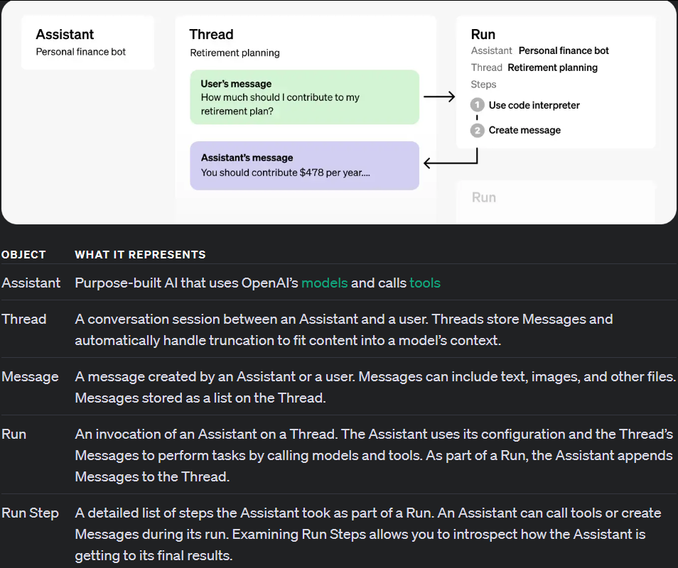
You Are Here
Notes:
https://platform.openai.com/docs/assistants/how-it-works

Slide 5
ASSISTANT ONE
THREAD ONE
ASSISTANT TWO
RUNS
MESSAGE ONE
MESSAGE TWO
MESSAGE THREE
ASSISTANT THREE
Notes:
https://platform.openai.com/docs/assistants/how-it-works/runs-and-run-steps
https://platform.openai.com/docs/assistants/overview

Slide 6
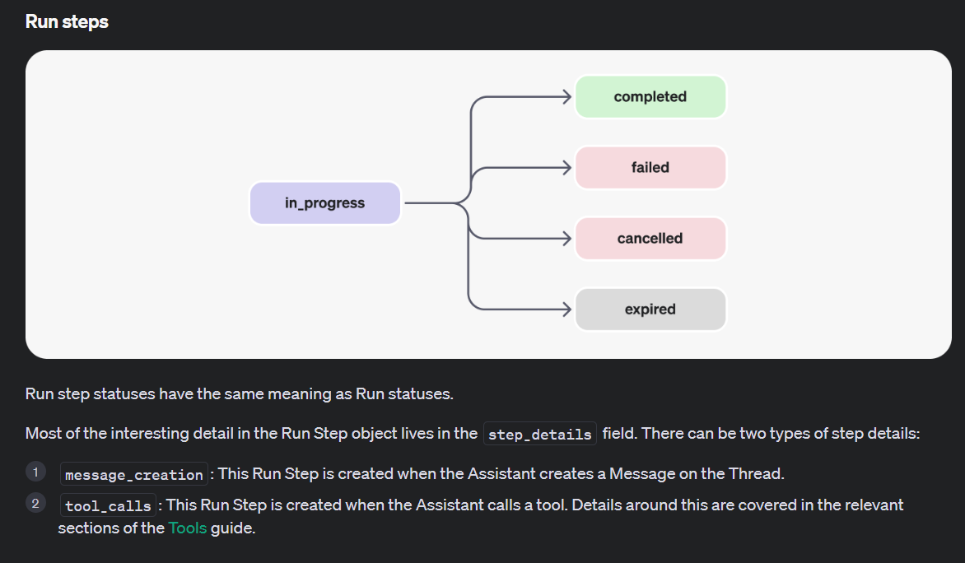

Slide 7
Listing Run Steps
Runs and Their Steps
Notes:
https://platform.openai.com/docs/api-reference/run-steps/listRunSteps

Slide 8
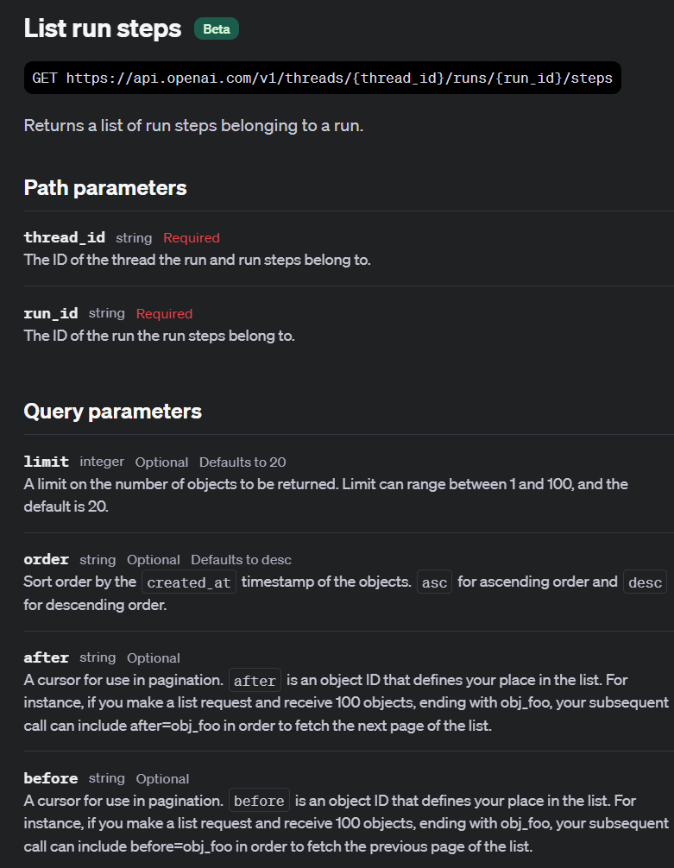

Slide 9
Demo: Listing Run Steps
all_run_steps = client.beta.threads.runs.steps.list(
thread_id=thread.id,
run_id=stream.get_final_run().id
)

Slide 10
Retrieving Run Steps
Getting the Details on What Happened
Notes:
https://platform.openai.com/docs/api-reference/run-steps/getRunStep

Slide 11
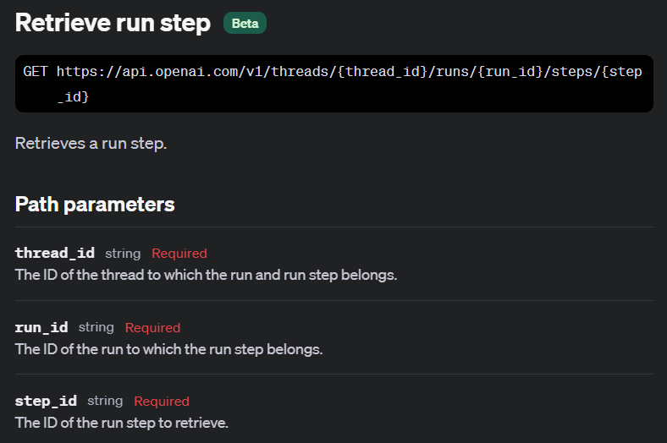

Slide 12
Demo: Retrieving Run Steps
# Retrieve the run step
run_step = client.beta.threads.runs.steps.retrieve(
thread_id=thread.id,
run_id=stream.get_final_run().id,
step_id=first_step.id
)

Slide 13


